Slide 1

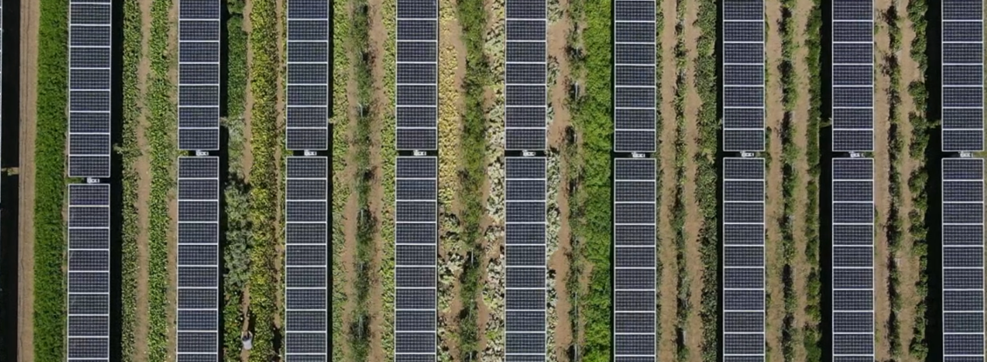
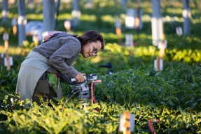
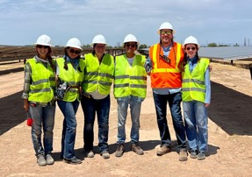
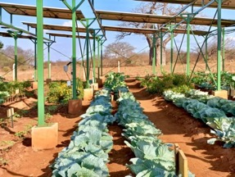
Home Research Education Sites News Team Contact
Semi-Arid Lab for Scalable Agrivoltaics
Short text about what is agrivoltaics, what impact it can have, etc.
Research Areas
Ecophysiology in Agrivoltaics Systems
Scaling Up Agrivoltaics.
Scaling Out Agrivoltaics
Notes:
This would be the landing page for the SALSA group. There could be a nice banner image at the top (could be full bleed) – the one here is a still from drone footage we have that zooms out at Jack’s Solar Garden, so it communicates both what is agrivoltaics and the scaling piece pretty well. Would need a footer with contact info and logos at the bottom. You could click on each research area to be taken to a sub=page to learn more about the sites and projects that fall into each category

Slide 2
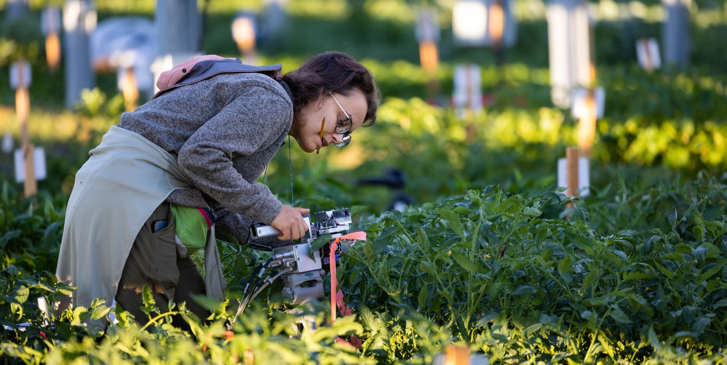
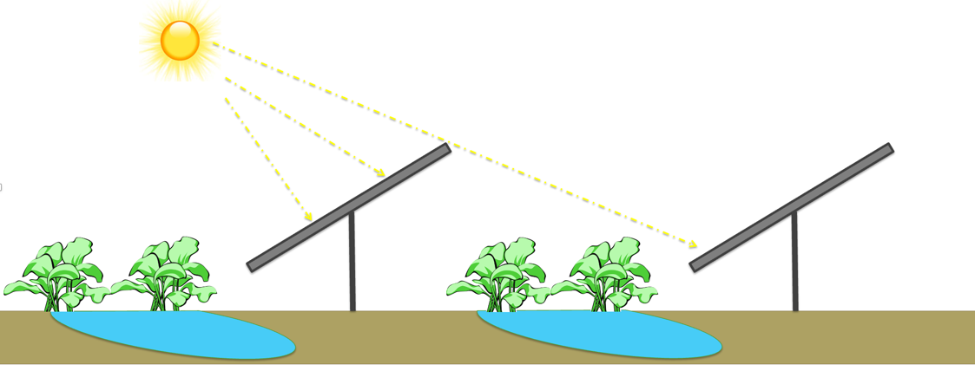
Home Research Education Sites News Team Contact
Ecophysiology in Agrivoltaics Systems
Blurb about research questions
Notes:
This would be a sub-page under research tab, focusing on the first group research area – ecophysiology.

Slide 3
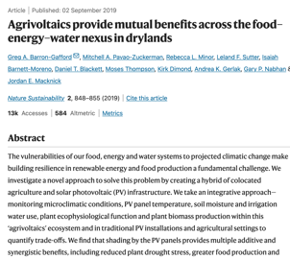
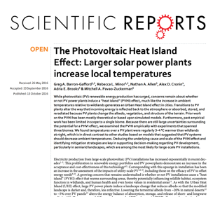
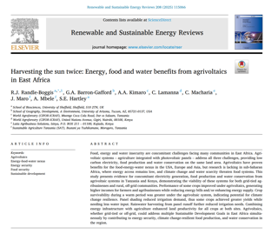
Home Research Education Sites News Team Contact
Ecophysiology in Agrivoltaics Systems
Blurb about research questions
Projects & Sites
B2
Jack’s
FARMS
Outputs
Notes:
After the blurb about each research area, there could be cards that link to the projects/sites and to key outputs (papers, news stories, etc) about each research area. Need to create cards for each research site.

Slide 4
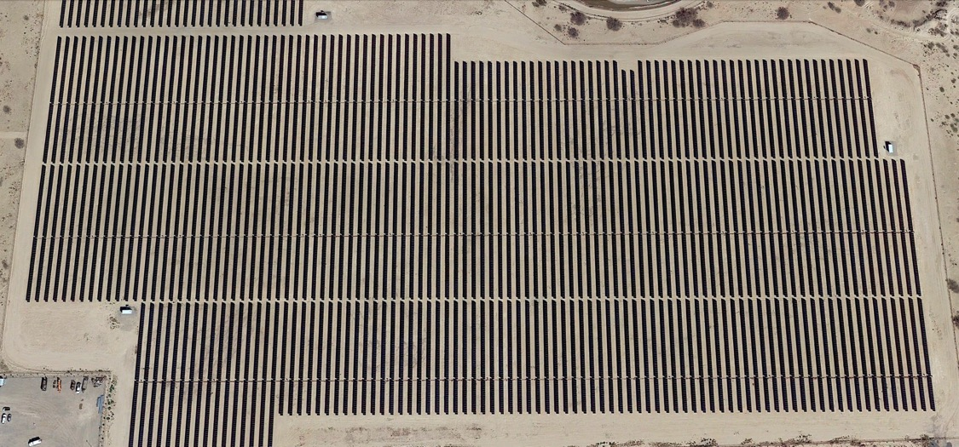
Home Research Education Sites News Team Contact
Agrivoltaics from kW to MW scale
Blurb about research questions
MW
FARMS
Scapes
JSG
Ag-centric
B2
Energy-centric
HH
kW
Notes:
Research page for ‘Scaling Up’. The projects/sites in the scaling typography could link to those sections in the Projects/Sites tab. I’d also duplicated the Projects & Sites cards and the Outputs cards at the bottom of this page, and link the relevant research outputs here.

Slide 5
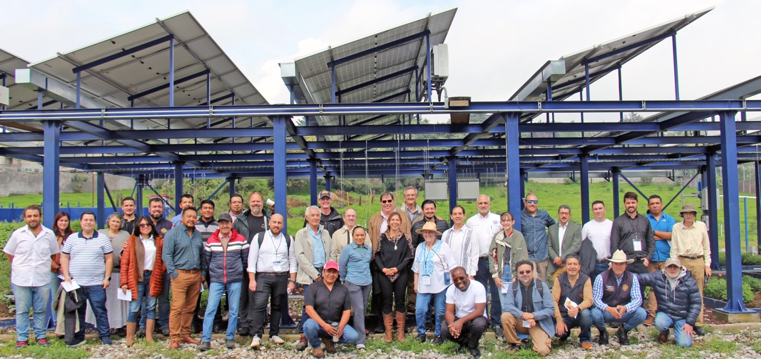
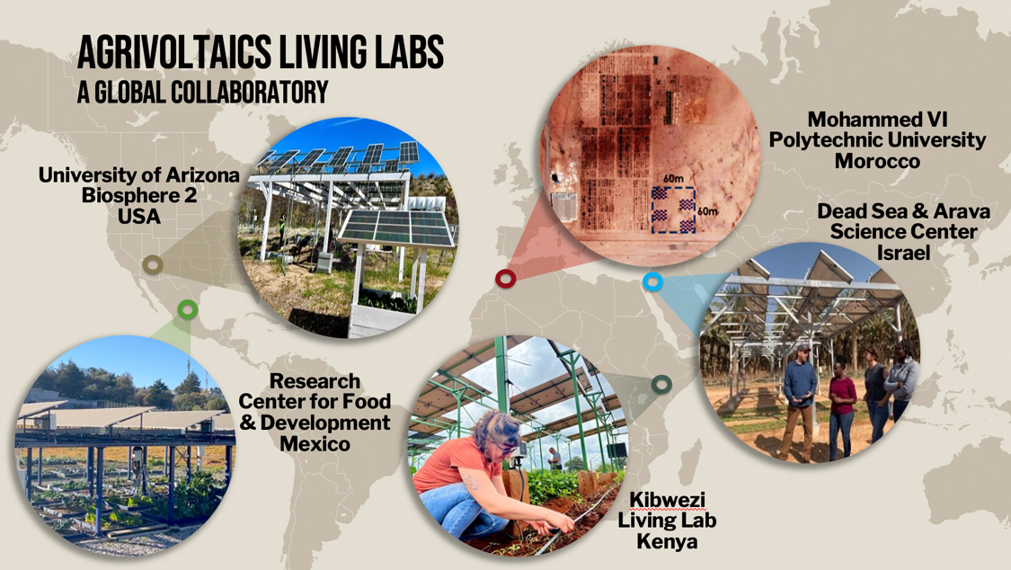
Home Research Education Sites News Team Contact
Scaling Out Agrivoltaics – Impact across Contexts
Suitability & system design questions.
Partnerships for exploring agrivoltaics research questions across diverse social-ecological contexts.
A big way we do that is through Agrivoltaics Living Labs
Notes:
This would be a sub-page under research tab, focusing on the third research area – scaling out. This focus in agrivoltaics across contexts, climates, use cases, etc. a big highlight should be the international partnerships and sites. We can also highlight the outputs that relate to international projects, and suitability and design questions (duplicating the same sites / outputs cards as before)

Slide 6
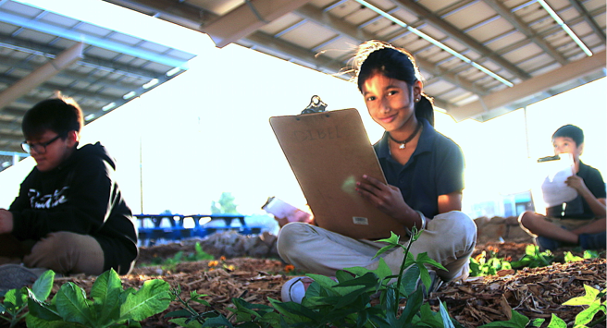
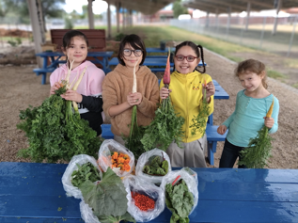
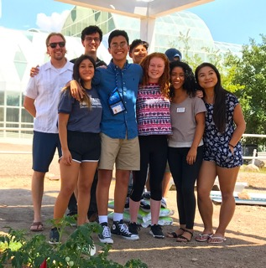
Home Research Education Sites News Team Contact
Training & Education for Agrivoltaics
Why is education and training on agrivoltaics so important?
School Garden Program
Global School of Agrivoltaics
Interdisciplinary Opportunities
Notes:
Main page for the Education section, an overview of why education and training for AV is so important (interdisciplinary, etc). Then highlight some key efforts, could be linked to other pages. E.g. school garden program, student opportunities, the Global School of Agrivoltaics, etc. Any outputs associated with this stuff could have cards at the bottom as well.

Slide 7
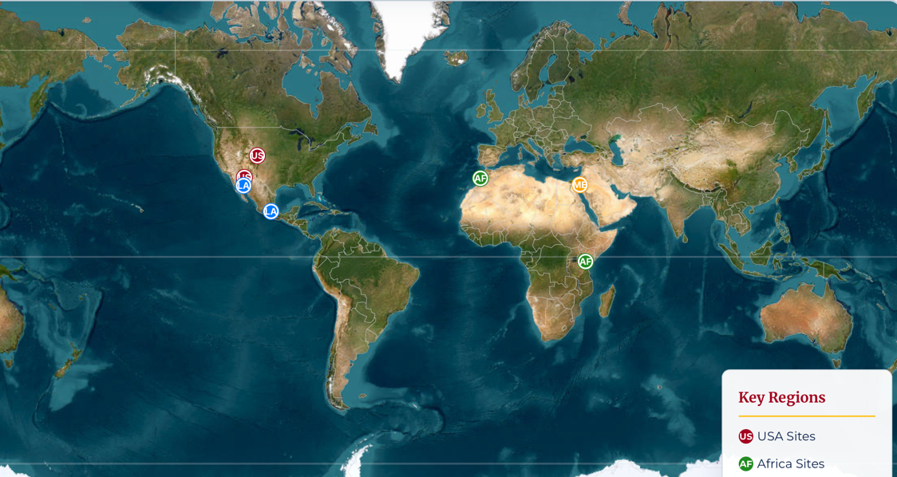
Home Research Education Sites News Team Contact
Notes:
The interactive map can sit here and link to the research areas on the cards?

Slide 8
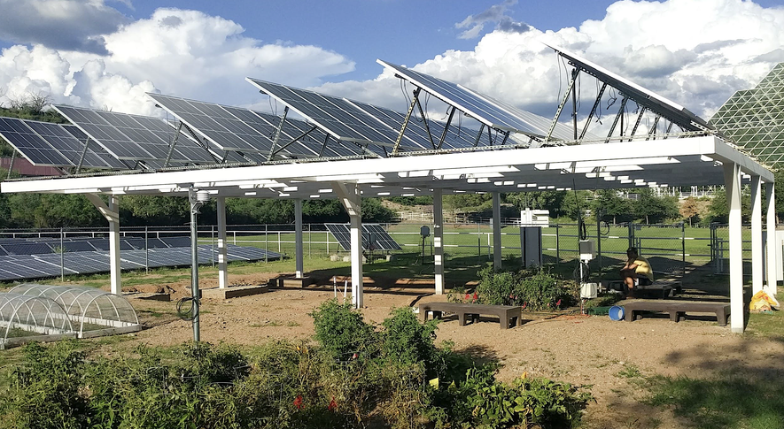
Home Research Education Sites News Team Contact
News & Publications
filters
Type
Paper
Video
Paper
Article
Article
Paper
Notes:
An area for all of the outputs from the agrivoltaics work, including academic papers, but also news articles, videos, and other pubs. Best word to use for this section?
Can we do it where all of the outputs are ‘cards’ and you can filter by type or year? A large example is here: https://www.cifor-icraf.org/knowledge/publications/

